Slide 1

FOCUS - Acting on Cloud IMPACT
A FinOps framework to optimize costs and help reduce carbon footprint

Slide 2
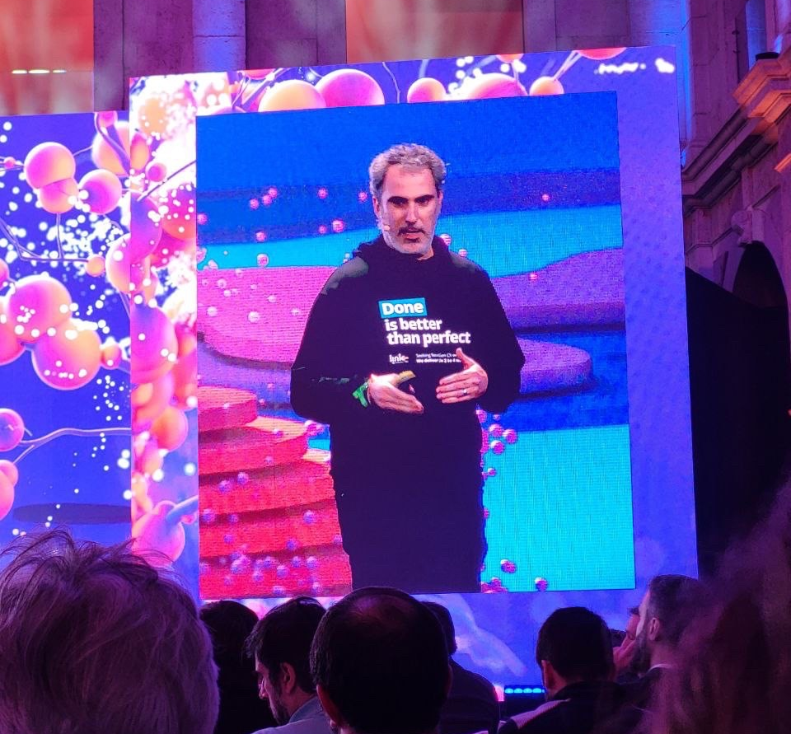
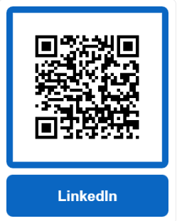
About the speaker
20+ years of experience in IT, 16+ at Link
Director of ICE, the coolest Tech Team on the planet!
Areas of Expertise: Integration, Cloud and Experience Engineering
Business-driven Solution Designer and Architect
A keen speaker, loves to share his knowledge and make his teams thrive
https://www.linkedin.com/in/joserodriguesbpm/

Slide 3
The Challenge

Slide 4
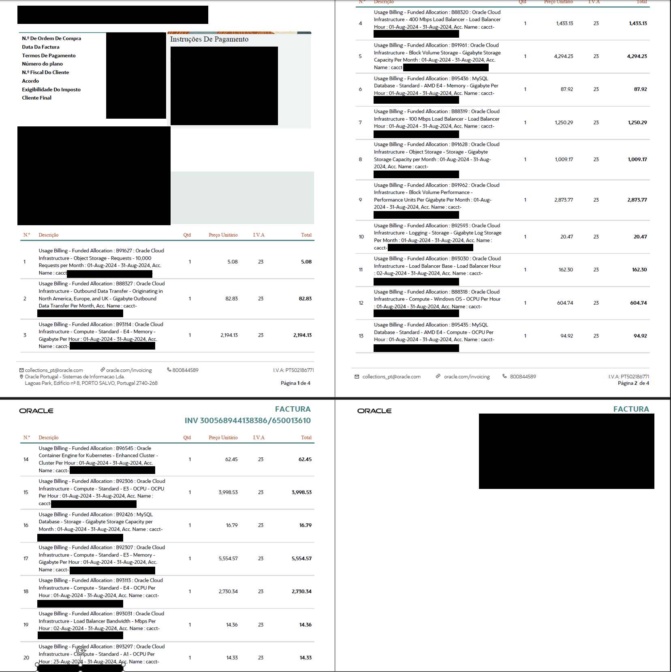
Business Challenge
Who the hell knows what’s inside a cloud provider invoice?
The right answer is typically…. nobody!
Cloud bills keep growing and growing, more recently fueled by the new/old gold rush – data.
It takes a lot of storage
It takes a lot of compute power
It’s ever-growing: compute is ephemeral but data…. data is what we keep!
And then there’s the magic sauce… Data transfer/Egress
Cloud billing models are complex, with each service having its own metrics and ways to influence the overall cost.

Slide 5
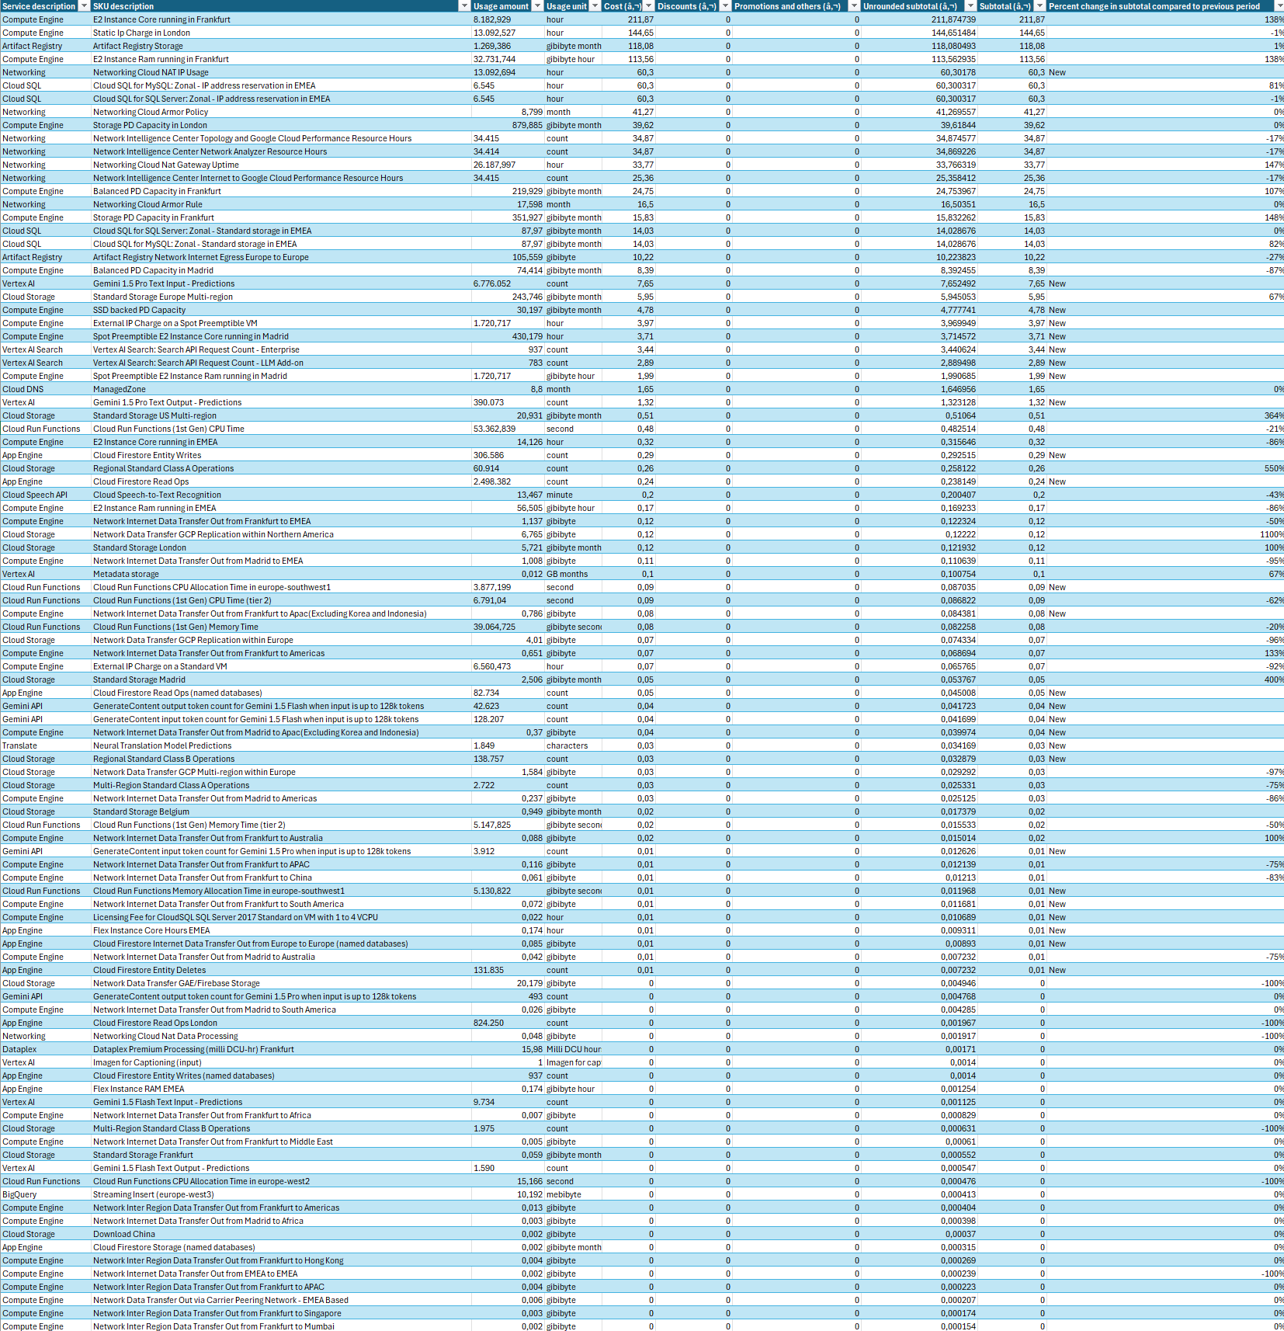
Business Challenge
Who the hell knows what’s inside a cloud provider invoice?
Some cloud providers offer a somewhat simpler invoice structure, others offer more detail.
But, they are typically different, and that:
Makes you need to understand different outputs and reports
Makes you deal with different names for the same thing
Makes it harder to automate and have a centralized approach
Makes it harder to manage a multi-cloud environment
Monthly Billing Report - Page 1 of … 5

Slide 6
You Can’t manage what you can’t measure
An old Adage that still holds true…

Slide 7
FOCUS – A FinOPS Framework

Slide 8
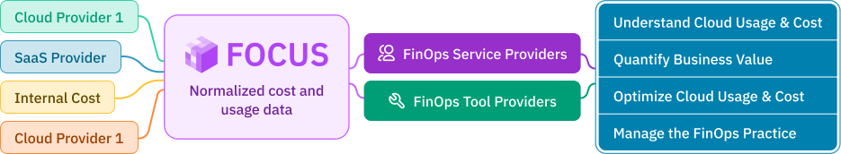
(F)inOps (O)pen (C)ost & (U)sage (S)pecification
Open-Source project to produce FinOps-serviceable datasets.
It’s a specification to perform typical FinOps operations:
cost-allocation
Chargeback
Forecasting and budgeting
Vendor-independent, with the possibility to add SaaS providers and even On-premise costs.
Main vendors adopting
The secret sauce is the common data and lexicon specification: The FOCUS Datasets

Slide 9
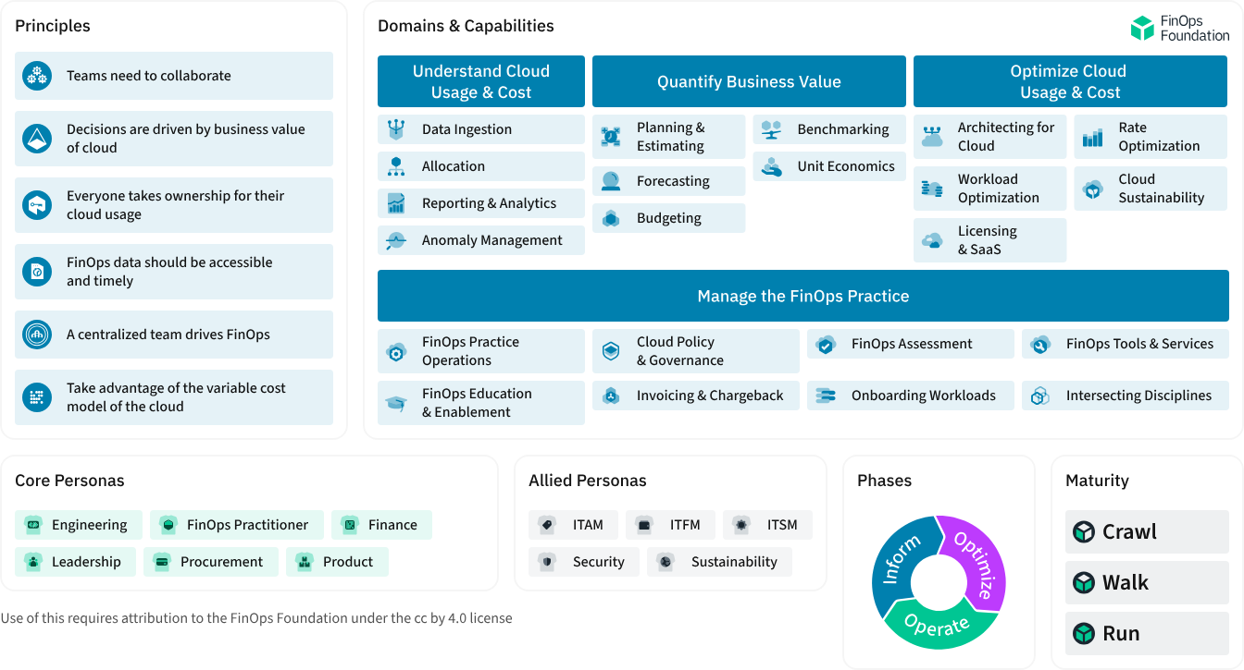
Focus main elements

Slide 10
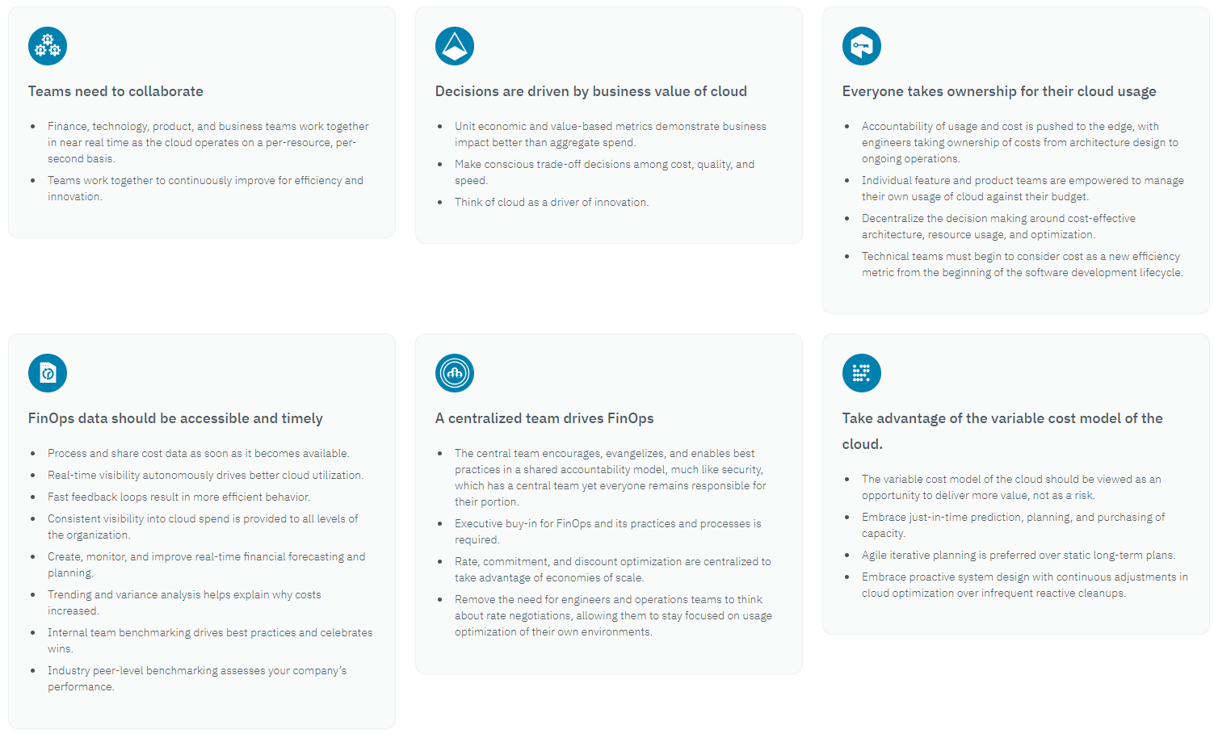
FinOps Principles
Act as a North Star, guiding the FinOps pratice

Slide 11
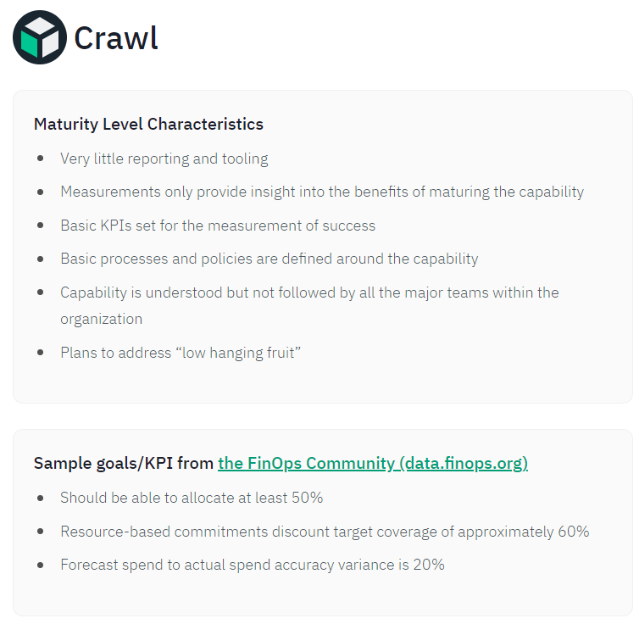
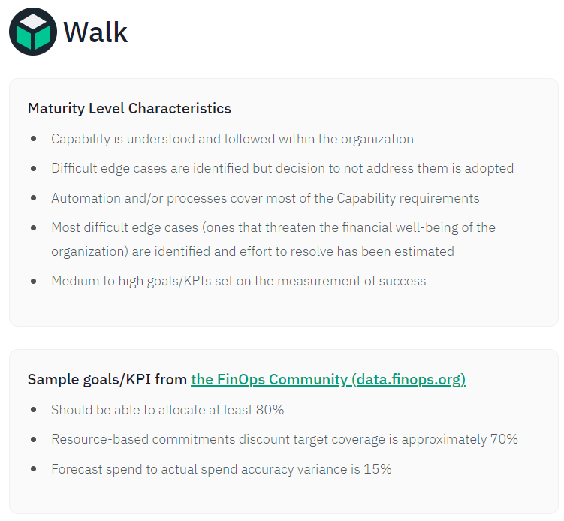
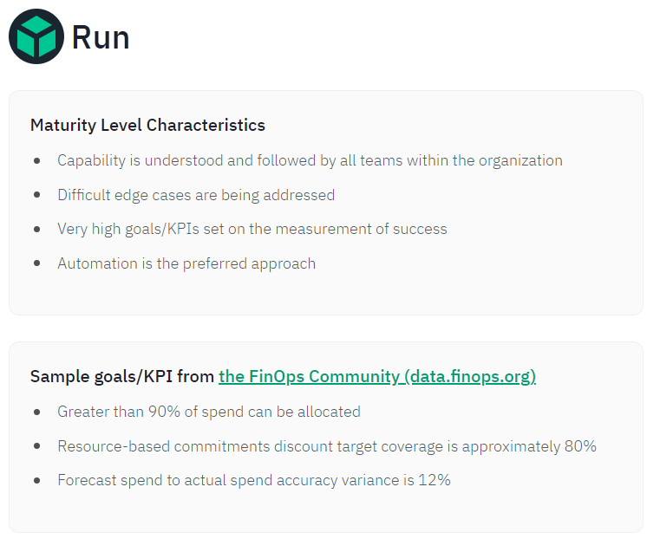
FinOps Maturity Level
Evaluation of current level is highly recommended.
There’s an assessment tool available at: https://www.finops.org/wg/finops-assessment/

Slide 12
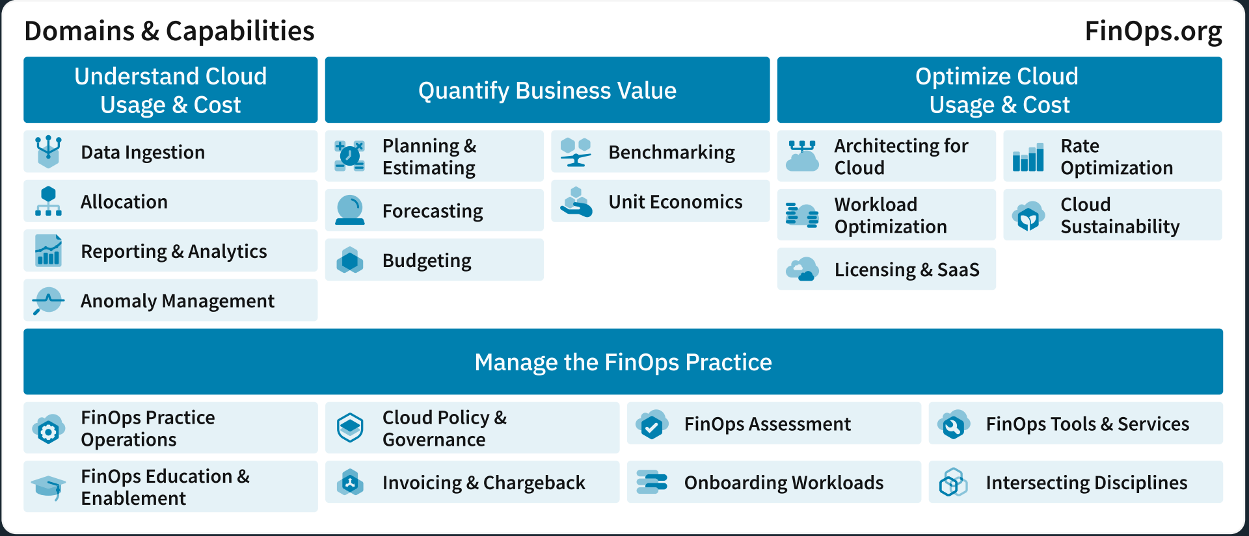
FinOps Domains
Understand Cloud Usage & Cost
The outcome of this Domain is better understanding of an organization's use of the cloud.
Within this Domain, organizations work to gather all the information required to perform FinOps.
This includes direct and imputed cloud cost, cloud usage, observability, utilization, and sustainability data, and other datasets required by any FinOps Domain.
Activities in this Domain also define the organizational metadata to categorize, allocate and summarize cloud cost and usage, and define the reporting and analytics processes making that data available for use by all FinOps Personas.

Slide 13
FinOps Domains
Quantify Business Value
Organizations develop Capabilities in this Domain to connect the usage and cost data with the business value it creates, helping ensure value is transparent and within expectations.
Within this Domain, organizations map monetary and non-monetary cloud costs to budgets, use historical information and future plans to forecast, establish and measure technical and organizational KPIs, and perform benchmarking across teams, business units and with other organizations.

Slide 14
FinOps Domains
Optimize Cloud Usage & Cost
This Domain focuses on cloud efficiency, ensuring organizations only use the resources when they provide value to the organization; and that resources used are purchased at the lowest acceptable cost and impact to meet the organization’s goals.
Organizations will measure efficiency in a variety of ways, including monetary cost, carbon usage, or more traditional IT operational efficiency measures.
Capabilities in this Domain allow the organization to manage the types, timing and amounts of cloud resources used, and the rates that are paid for those resources.
Capabilities here also address architecture modernization, sustainability considerations for FinOps teams, and the use of licensed and consumption-based SaaS products.

Slide 15
FinOps Domains
Manage the FinOps Practice
This Domain enables continuous improvement to change and align the entire organization - its people, processes and technology - to adopt FinOps and use cloud in ways that create value for the company.
Capabilities here are centered on effective FinOps operation, enablement of the whole organization, improved interaction with all other personas and business functions to support and represent cloud use more effectively.

Slide 16
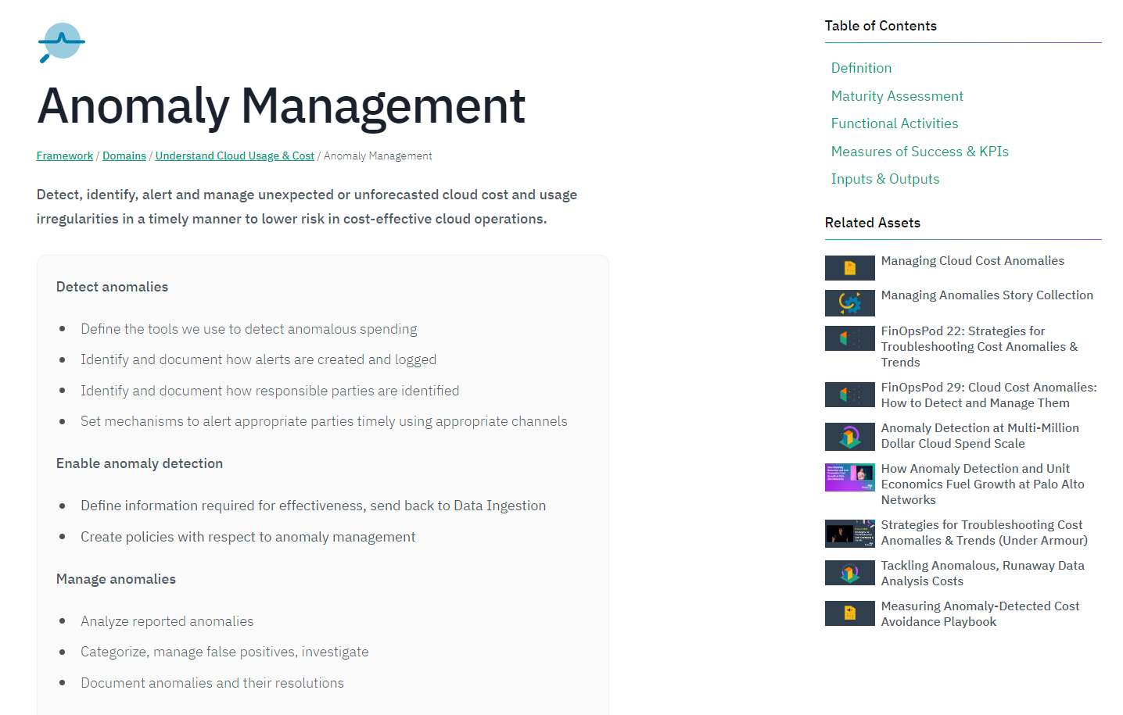
FinOps Capabilities
What and how-to (fast)
Each Capability is defined and explained, with a clear description of
What is expected of it per maturity level.
What is expected per persona involved.
Reference KPIs and Measures of Success
Outputs and Inputs
This allows for a very concrete and defined understanding of what is done, what needs to be done and who to involve.
It also features a set of accelerators for adoption and control of the capability
Let’s look at an example: https://www.finops.org/framework/capabilities/anomaly-management/

Slide 17
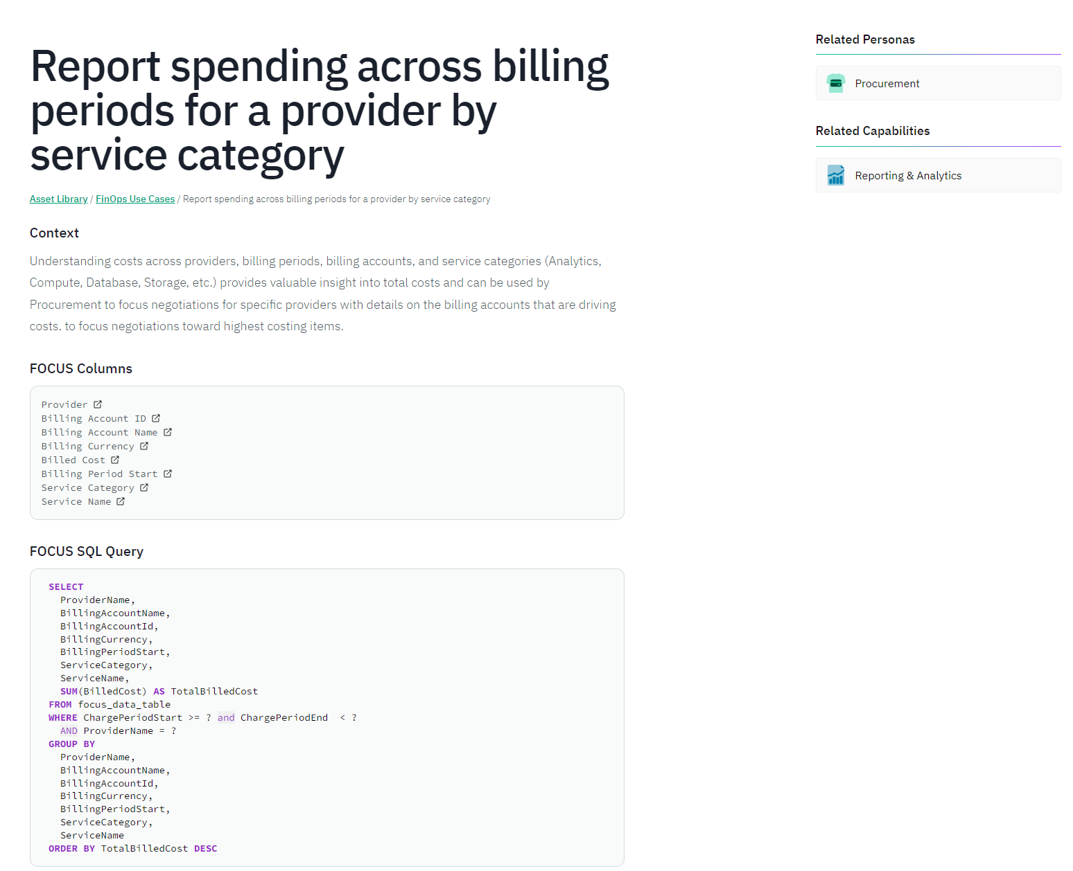
FinOps Use CAses
Frequent “how to do” FinOps
There’s a series of typical FinOps use-cases, situations or challenges that the personas involved in FinOps may find recurrent in their work.
There are approx. 40 now available, with the number increasing regularly.
As the FOCUS dataset is standardized, a FOCUS-enabled SQL Query is also made available.
Let’s look at an example: https://www.finops.org/assets/use-cases/report-spending-across-billing-periods-by-service-category/

Slide 18
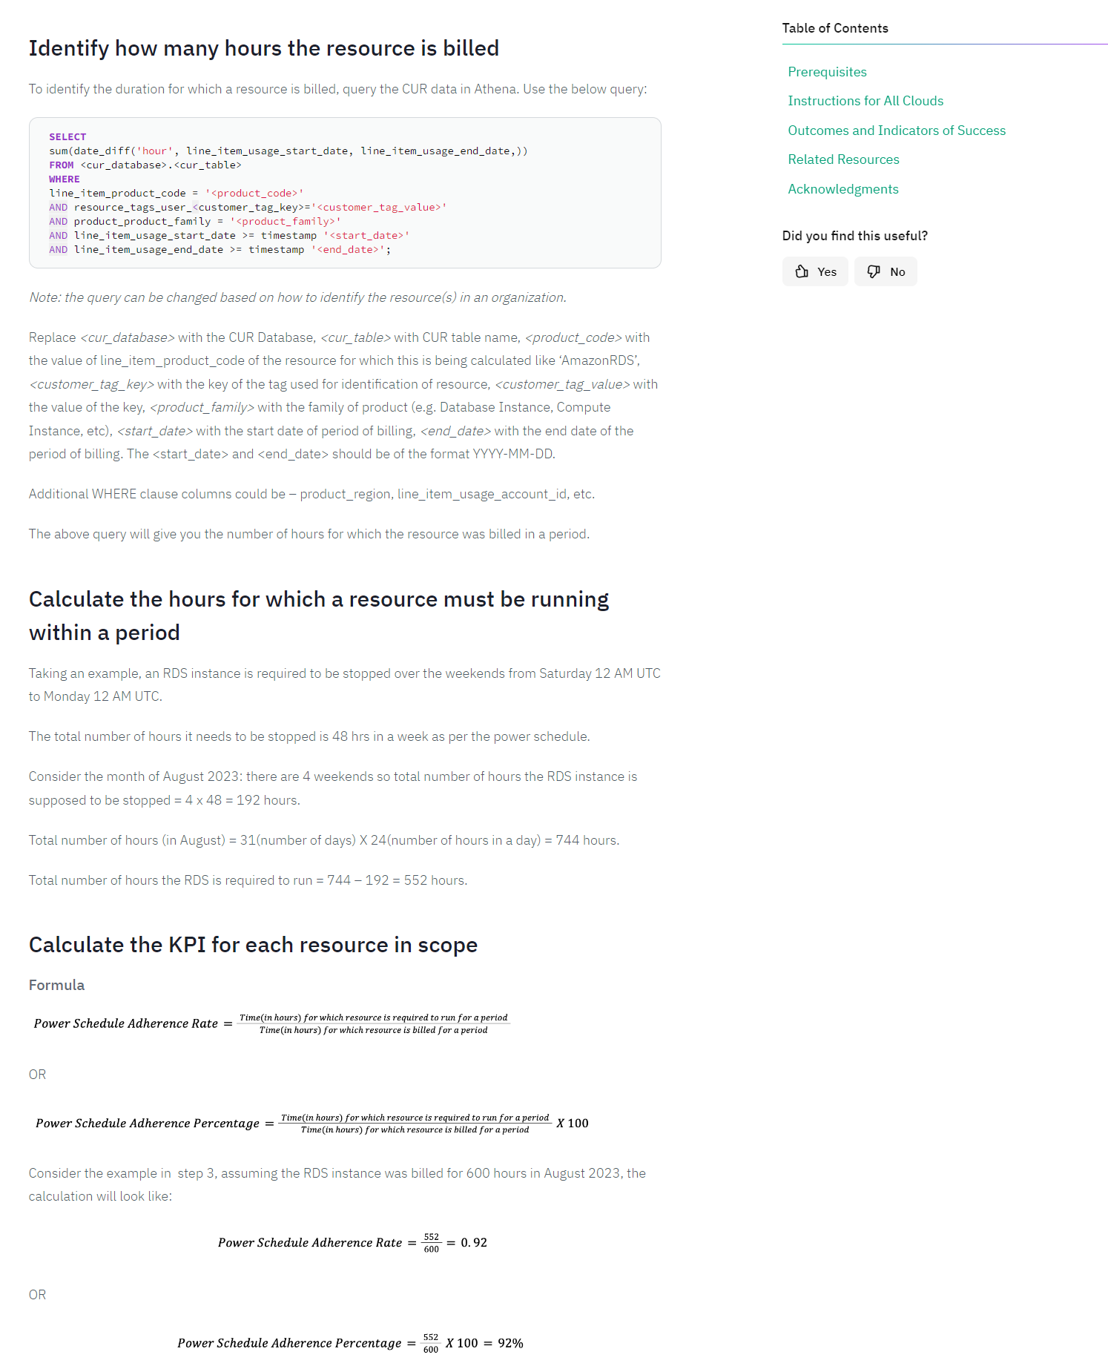
FinOps Playbooks
Community-based how-to’s to address specific needs
Besides the actual official framework documents, the community is also invited to participate, adding ways to address everyday FinOps challenges in organizations.
These pre-made solutions are called playbooks, and there’s a ton of them available, with some fairly simple, and some others highly detailed.
Let’s look at examples:
https://www.finops.org/wg/how-to-measure-power-schedule-adherence-rate-percentage/ https://www.finops.org/wg/percent-commitment-based-discount-waste-playbook/

Slide 19
Let’s look at a scenario
A sample question from the FOCUS Analyst Certification Exam
You’ve been asked to optimize your organization’s cloud costs.
You have a FOCUS dataset at hand and start to analyse it. You find this line which seems interesting.
Block & Fractional Block Pricing
In block pricing, a block is purchased (e.g. 1 block = 2000 hours) and in fractional block pricing, fractions of a block can be purchased (e.g. 2.2 blocks = 2200 hours).
Considering the item is a Fractional Block Pricing one, with fractional block pricing increments of 0.5, what would be the best optimization strategy to follow?
Propose finding ways to reduce the effective cost of this item
Propose a way to increase the number of fractional blocks from 1.5 to 2.0
Propose finding ways to reduce usage slightly to avoid paying for the additional 0.5 block
Propose finding ways to reduce the contracted rate for this item
Pricing Strategy | Item Description | Charge Category | Pricing Quantity | Pricing Unit | List Unit Price | List Cost | Contracted | Contracted Cost | Billed Cost | Effective Cost | Consumed Quantity | Consumed Unit
Fractional Block Pricing | AI Tokens | Usage | 1,5 | 1000 Tokens | 1,00 | 1,50 | 0,90 | 1,35 | 1,35 | 1,35 | 1005 | Tokens

Slide 20
Crossing FinOps data with carbon Footprint

Slide 21
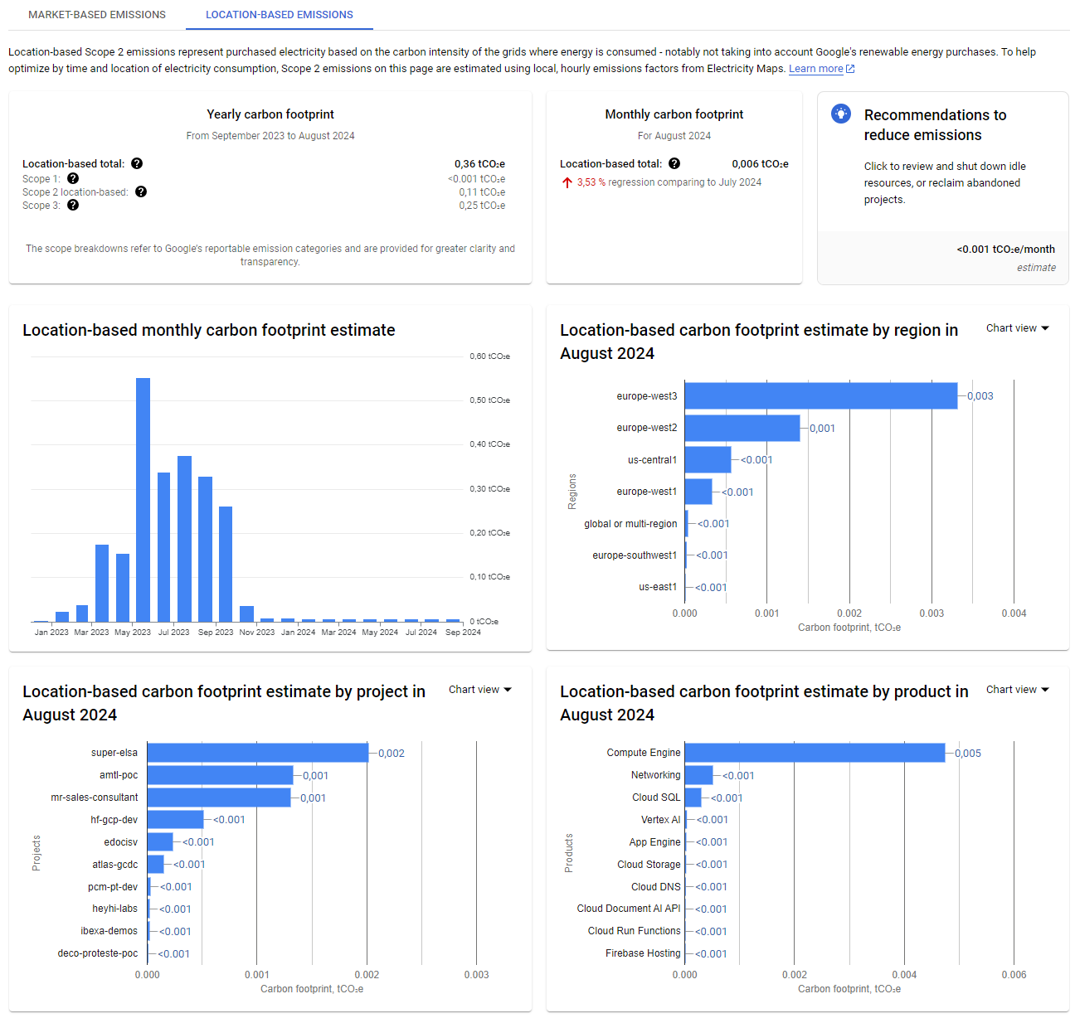
Getting the carbon data
As provided by the cloud vendors
All main cloud vendors are now providing carbon-related data, so that companies can measure and act upon to achieve their sustainability goals.
Very soon, it will be mandatory to have all this data to help with the sustainability reports.
Google: https://console.cloud.google.com/carbon
Microsoft: https://www.microsoft.com/en-in/sustainability/emissions-impact-dashboard (has an API still in preview mode)
AWS: https://aws.amazon.com/aws-cost-management/aws-customer-carbon-footprint-tool/
Oracle: https://docs.oracle.com/en-us/iaas/Content/General/Tasks/carbon-analysis-viewreports.htm
It’s possible to generate Carbon-Impact datasets, per service, per location and per project.
Crossing FOCUS datasets with carbon-impact datasets allows for workload carbon-impact reporting and analysis.
Link is currently working on an accelerator to have this fully integrated on a single report, with multi-cloud vendor sources.

Slide 22
It’s not just nice… it’s ICE!
José Rodrigues
Director of ICE [Integration, Cloud and Experience]
jose.Rodrigues@linkconsulting.com
+351 969 441 364

